Slide 1
Module-5
Registers and counters

Slide 2
Topics
Registers and Register Transfers
Parallel Adder with accumulator
Shift registers
Design of Binary counters
Counters for other sequences
Counter design using SR and J K Flip Flops
Sequential parity checker
State tables and graphs

Slide 3
Getting Comfortable
A register consists of a group of flip-flops with a common clock input.
Registers are commonly used to store and shift binary data.
A counter is usually constructed from two or more flip-flops which change states in a prescribed sequence when input pulses are received.

Slide 4
REGISTERS AND REGISTER TRANSFERS
D flip-flops are grouped together with a common clock to form a register

Slide 5
When Load=0, the register is not clocked, and it holds its present value.
When Load=1, the clock signal (Clk) is transmitted to the flip-flop clock inputs and the data applied to the D inputs will be loaded into the flip-flops on the falling edge of the clock.
The flip-flops in the register have asynchronous clear inputs that are connected to a common clear signal, ClrN

Slide 7
Data Transfer Between Registers

Slide 8
Logic Diagram for 8-Bit Register with Tri-State Output

Slide 9
Data Transfer Using a Tri-State Bus

Slide 10
PARALLEL ADDER WITH ACCUMULATOR
X = xn . . . x2x1 is stored in the accumulator
Y = yn . . . y2y1 is applied to the full adder inputs
After the carry has propagated through the adders, the
sum of X and Y appears at the adder outputs
An add signal (Ad) is used to load the adder outputs
into the accumulator flip-flops on the rising clock edge

Slide 11
Steps:
Clear the accumulator using the asynchronous clearinputs on the flip-flops.
Load accumulator with X data.
Put Y data to adders.
Add adder data to the accumulator

Slide 12
Adder cell with mux

Slide 13
SHIFT REGISTERS

Slide 14
4-bit right-shift register with serial input and output constructed from D flip-flops

Slide 15
8-bit serial-in, serial-out shift register

Slide 16
4-bit parallel-in, parallel-out shift register

Slide 17
Shift register with inverted feedback

Slide 18
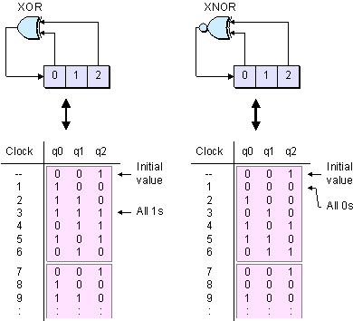
LFSR

Slide 19
DESIGN OF BINARY COUNTERS Asynchronous counters:

Slide 20
Synchronous Binary Counters Using T Flip-Flops

Slide 21
Design

Slide 22
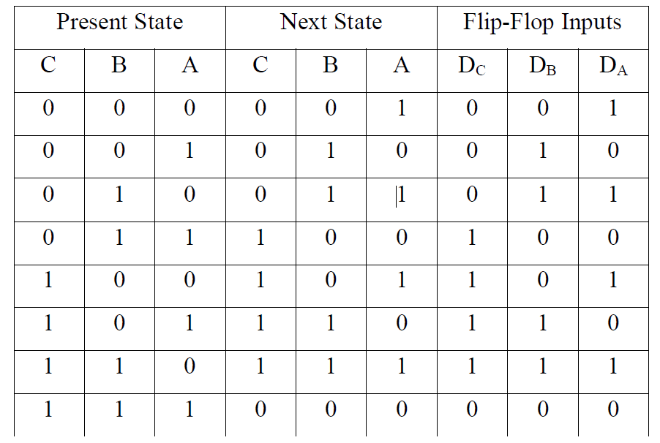
Synchronous Binary Counters Using D Flip-Flops

Slide 24
Binary Up-Down Counter

Slide 25
Binary Up-Down Counter
When U = 1 and D = 0, these equations reduce to equations for a binary up counter
When U = 0 and D = 1, these equations reduce to

Slide 26
Loadable Counter

Slide 27
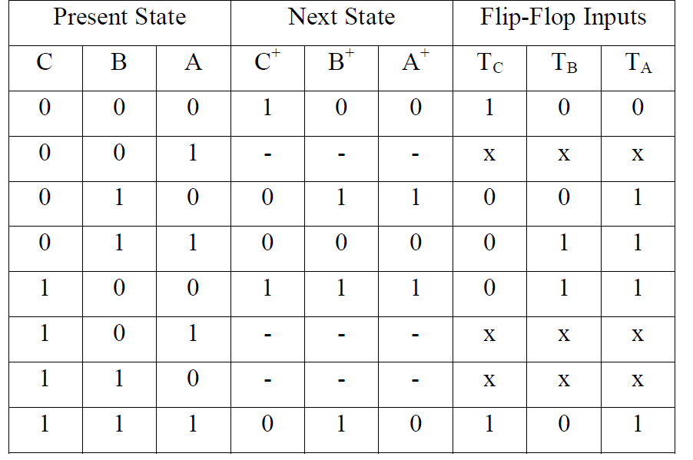
COUNTER FOR OTHER SEQUENCES

Slide 28
COUNTER FOR OTHER SEQUENCES

Slide 29
COUNTER FOR OTHER SEQUENCES

Slide 30
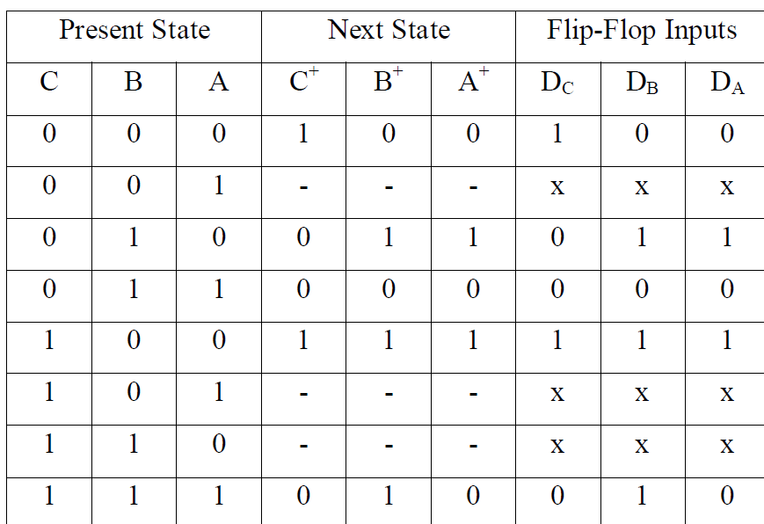
self correcting counter

Slide 31
self correcting counter

